Slide 1
CSE322
Turing
Machine Model
&
Representation and Design of Turing
Machines
Lecture #36

Slide 2
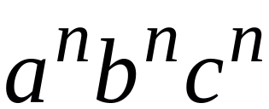

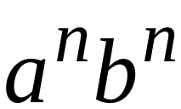



Languages accepted by
Turing Machines
Context-Free Languages
Regular Languages

Slide 3
A Turing Machine
Tape
......
......
Read-Write head
Control Unit

Slide 4
The Tape
No boundaries -- infinite length
......
......
Read-Write head
The head moves Left or Right

Slide 5
......
......
Read-Write head
The head at each transition (time step):
1. Reads a symbol
2. Writes a symbol
3. Moves Left or Right

Slide 6






Time 0
......
......
Time 1
......
......
1. Reads
2. Writes
3. Moves Left

Slide 7



Time 1
......
......
Time 2
......
......
1. Reads
2. Writes
3. Moves Right

Slide 8

The Input String
Input string
Blank symbol
......
......
head
Head starts at the leftmost position
of the input string

Slide 9




States & Transitions
Write
Read
Move Left
Move Right

Slide 10
Time 1
......
......
current state

Slide 11
Time 1
......
......
Time 2
......
......

Slide 12
Time 1
......
......
Time 2
......
......

Slide 13


Time 1
......
......
Time 2
......
......

Slide 14



Determinism
Turing Machines are deterministic
Allowed
Not Allowed
No lambda transitions allowed

Slide 15

Partial Transition Function
......
......
Allowed:
No transition
for input symbol

Slide 16
Halting
The machine halts in a state if there is
no transition to follow

Slide 17
Halting Example 1:
......
......
No transition from
HALT!!!

Slide 18
Halting Example 2:
......
......
No possible transition
from and symbol
HALT!!!

Slide 19
Accepting States
Allowed
Not Allowed
Accepting states have no outgoing transitions
The machine halts and accepts

Slide 20
Acceptance
If machine halts
in an accept state
Accept Input
string
If machine halts
in a non-accept state
or
If machine enters
an infinite loop
Reject Input
string

Slide 21
Observation:
In order to accept an input string,
it is not necessary to scan all the
symbols in the string

Slide 22
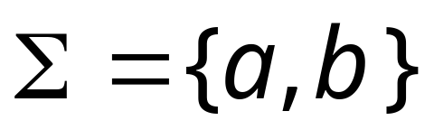
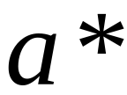



Turing Machine Example
Input alphabet
Accepts the language:

Slide 23
Time 0
Fall 2006
Costas Busch - RPI

Slide 24
Time 1

Slide 25
Time 2

Slide 26
Time 3

Slide 27

Time 4
Halt & Accept

Slide 28
Rejection Example
Time 0

Slide 29
Time 1
No possible Transition
Halt & Reject

Slide 30
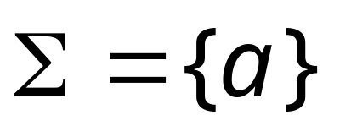
A simpler machine for same language
but for input alphabet
Accepts the language:

Slide 31
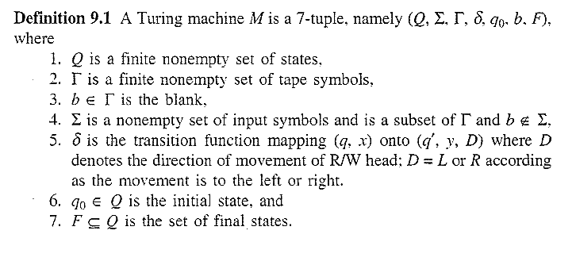

Formal Definition

Slide 32
Representation of Turing Machine
By instantaneous description
By transition table
By transition diagram

Slide 33
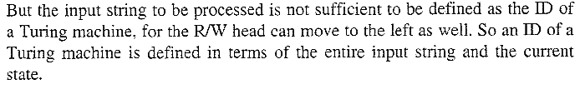
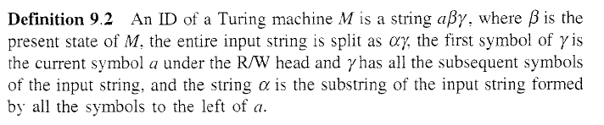
Representation by Instantaneous Description
ID of PDA has been defined by (q, a, Z)

Slide 34
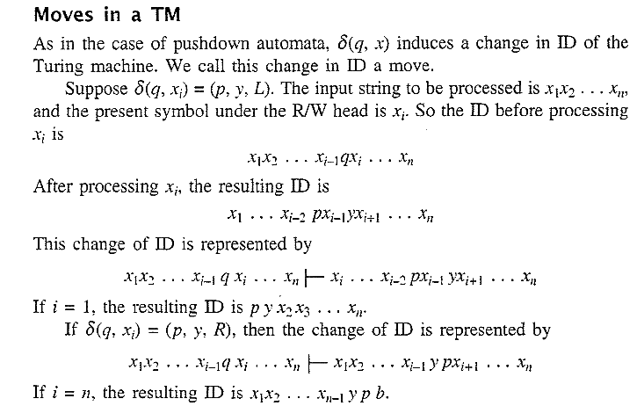

Slide 35
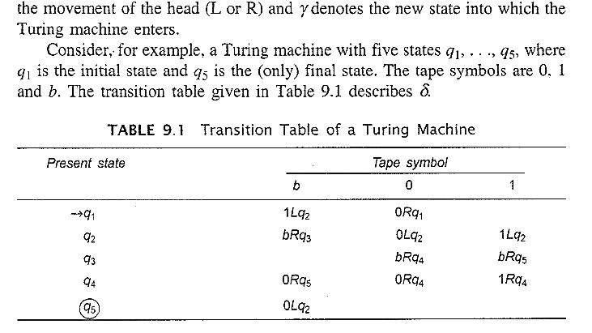
Representation by transition table
Definition of delta is given by transition table. If

Slide 36
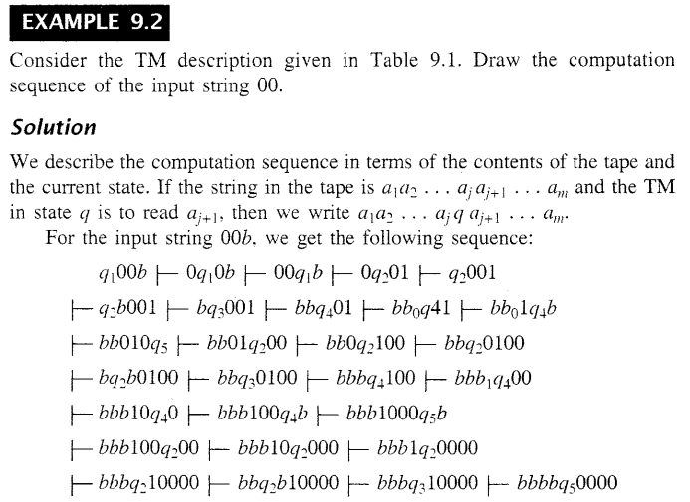

Slide 37
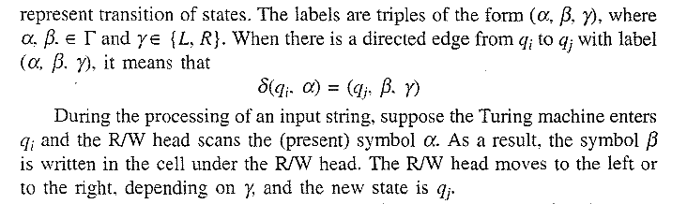
Representation by Transition diagram

Slide 38
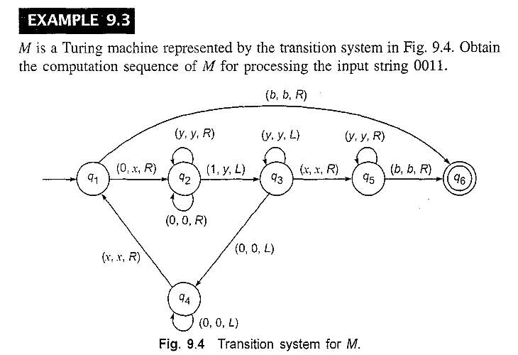

Slide 39
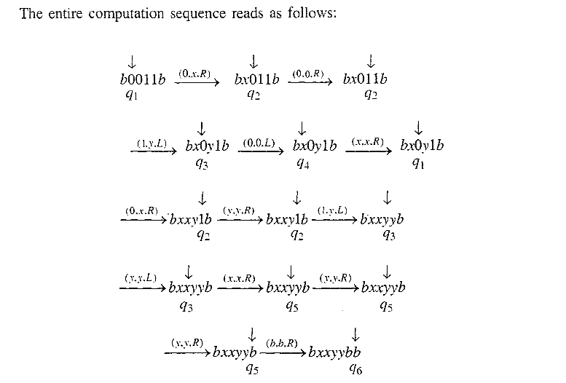
Solution

